Slide 1
DNA Damage and Mechanisms of Repair
Christian Happi

Slide 2
Overview
DNA damage
  Types
  Consequences
  Sources
DNA repair pathways
  Mismatch Repair
  Base Excision Repair
  Nucleotide Excision Repair
DNA damage/repair and drug resistance
Applications to Plasmodium falciparum

Slide 3
Definitions
Mutation: a heritable change in the genome sequence of an organism
Mutagen: an agent that causes an increase in mutation frequency
Mutant: an organism that has one or more mutations in its genome
Wild-type: an organism with the “normal” genome

Slide 4
Types of Mutations
Point mutations
GATTATC GATAATC
Deletions
GATTATC GATC
Insertions
GATTATC GATCAGTATC
Notes:
Point mutations: mutations that result from the substitution of 1 nucleotide for another or from the addition or deletion of a small number of nucleotides.
Deletions: removal of nucleotide(s) from the DNA strand
Insertions: addition of extra nucleotide(s) into the DNA strand

Slide 5
Types of Mutations
Inversions
Translocations
Notes:
Inversions: inversion of a region of a chromosome
Translocations: attachment of a segment from 1 chromosome to another chromosome.

Slide 6
Missense mutations: mutations that change the codon from 1 amino acid to another
  Asn: AAC → Tyr: TAC
Nonsense mutations: mutations that change the codon of an amino acid to a stop codon
Tyr: TAC → Stop: TAA
Silent mutations: mutations that change the codon of an amino acid to a different codon for the same amino acid
Thr: ACC → Thr: ACA
Frameshift mutations: mutations that cause a change in the translational reading frame
Pro Thr Ala +T Pro Tyr Gly
CCC ACG GCG CCC TAC GGC G
Notes:
Codon: sequence of three nucleotides in DNA or messenger RNA that represents a specific amino acid.

Slide 7
Consequences of DNA Mutations
Location of Mutation | Effect of Mutation
Coding region | Complete/partial loss of function; gain of function; change of function; no effect
Promoter | Increase or decrease in gene expression
Intron | Possible defects in mRNA splicing
Example
DNA
TAG
Transcription
RNA
Translation
Protein
Notes:
The end result of DNA mutations vary depending on the location of the mutation. If the mutation is in the coding region, the protein sequence may be affected, leading to a complete or partial loss of function, a gain or alteration of function or perhaps even no change in function. Mutations in the promoter region or regulatory sequence of a gene can result in the alteration of gene expression. Even mutations in noncoding sequences, such as in introns, could affect the gene product as it may lead to defective mRNA splicing.
An example is shown on the right: A nonsense mutation in the DNA sequence changes the codon to Stop (TAG). The DNA gets transcribed into RNA, but the stop codon results in the production of an incomplete protein product.

Slide 8
Causes of DNA damage
Intrinsic factors
  Errors in DNA replication
  Chemical instability of DNA
Extrinsic factors
  A)Endogenous agents
    Alkylating agents
    Oxidizing agents
  B)Exogenous agents
    Chemicals – chemotherapeutic agents
    Radiation
Notes:
DNA damage can be caused by various sources. These can be divided into intrinsic and extrinsic factors.
Intrinsic factors - factors associated with the DNA itself and can include errors during DNA replication or due to instability in the DNA strand.
Extrinsic factors - include endogenous agents (factors within the cell) like alkylating agents and oxidizing agents. Alkylating agents can add alkyl groups (ethyl, methyl…) to nucleotides and this can result in the addition of an incorrect nucleotide opposite the damaged nucleotide.
Exogenous agents (those derived from outside the cell) include chemicals, such as chemotherapeutic agents, and ionizing radiation or UV-irradiation. Chemicals for example can add adducts (foreign chemical groups) to the DNA resulting in misincorporation of DNA. Ionizing radiation can result in single and double-stranded DNA breaks.

Slide 9
General DNA Repair Mechanism
DNA damage
Ligation
Excision of damage
Resynthesis
Notes:
The general mechanism of DNA repair is as follows. Repair is initiated by the recognition of DNA damage by a repair enzyme(s) and this results in excision of the damaged DNA sequence. The excised portion of the DNA strand is subsequently resynthesized by DNA polymerases and the new DNA sequence is then ligated to the original DNA strand.

Slide 10
DNA Repair Pathways
DNA Repair Pathway | DNA Damage
Base Excision Repair | Large number of lesions (DNA adducts) and inappropriate bases
Nucleotide Excision Repair | Diverse DNA lesions/helix distortion
Mismatch Repair | DNA mismatches/insertions or deletions of 1-8 bp; recombination between divergent sequences
Notes:
Multiple DNA repair pathways exist for correcting the various kinds of DNA damage. Three of these pathways are shown here.
Base Excision Repair (BER): This is involved in the correction of various types of DNA lesions including DNA adducts and incorrect base-pairing. BER is generally involved in the repair of DNA damage that results only in minor disturbances in the DNA helix.
Nucleotide Excision Repair(NER): This corrects diverse DNA lesions and helix distortion in the DNA strands. Unlike BER, NER can also repair bulky DNA lesions and DNA damage that cause distortions of the DNA helix.
Mismatch Repair (MMR): This pathway is involved in postreplicative repair and can correct DNA mismatches, insertions or deletions of 1-8bp. Another function of the MMR pathway is inhibition of recombination between divergent sequences to act as a barrier to interspecies gene exchange.

Slide 11
Mismatch Repair Mechanism
CH₃
CH₃
(vi)
(i)
(ii)
(iii)
5’
G
3’
G
3’
T
5’
C
CH₃
CH₃
G
(v)
G
CH₃
CH₃
(iv)
methy.
unmethy.
MutS
MutL
MutH
Ssb
Pol-III holo
Adapted from Jiricny EMBO J 17:6427
Notes:
This is a model of the E. coli MMR pathway, which is the best characterized MMR pathway.
In the double-stranded DNA, the methylated (top) strand is the parent strand.
Step (i): A G-T mismatch is present in the double-stranded DNA.
Step (ii): The mismatch is bound by a MutS homodimer.
Step (iii): MutH binds the hemimethylated d(GATC) site and MutL forms a complex between MutS and MutH.
Step (iv): This interaction results in MutH nicking the d(GATC) site on the unmethylated (daughter) strand. Single-stranded binding (Ssb) protein binds to the complex.
Step (v): Exonucleases and helicase excise the portion of the daughter strand from the nick to beyond the mismatch. Single-strand binding (ssb) protein functions in stabilizing the unpaired portion of the DNA strand
Step (vi): DNA polymerase III resynthesizes the excised portion of the daughter strand.

Slide 12
Base Excision Repair
DNA glycosylase
AP endonuclease/dRpase
P
OH
DNA polymerase + DNA ligase
Notes:
A simplified representation of Base Excision Repair is shown here.
DNA glycosylases recognize certain forms of DNA damage and leads to the excision of the damaged base. This results in the generation of an apurinic or apyrimidinic (AP) site. AP endonucleases and a DNA deoxyribosephosphodiesterase (dRpase) attack the AP site and excise the portion of damaged DNA. Resynthesis and ligation of the excised DNA sequence is then completed by DNA polymerase and DNA ligase.

Slide 13
Nucleotide Excision Repair
T T
DNA damage incision
T T
5’
P
P
OH
OH
3’
Oligonucleotide excision
T T
5’
OH
P
P
OH
3’
DNA polymerase + DNA ligase
Notes:
A schematic representation of nucleotide excision repair is given here.
DNA damage such as pyrimidine dimers (shown in this model) are recognized and incised by a damage-specific endonuclease. This fragment is then released (excised). The resulting gap is then filled by DNA polymerase and repair is completed by DNA ligase.

Slide 14
DNA Repair and Drug Resistance
G
DNA replication
G
T
Mismatch recognition
G
G
T
T
Strand breakage
G
Cell death
T
  Defective DNA Repair: No attempts to correct replication error
Notes:
The process by which drug resistance is acquired is not entirely clear. One hypothesis is presented here. Drug treatment could result in damage to an organism’s DNA. This damage then leads to misincorporation of nucleotides during DNA replication. The cell attempts to correct this mistake. However the repair process corrects only the new daughter strand. The parent strand still contains the damaged DNA and therefore during the next daughter strand synthesis, an incorrect nucleotide is again incorporated. The cycle of correction is repeated several times and this can result in DNA strand breakage and therefore cell death.
It is thought that a cell with a defective DNA repair system may not attempt to correct the incorrect nucleotide. The cell therefore survives the drug treatment and this beneficial mutation is then selected for by the cell.
An example:
Methylating Agents (eg. Mercaptopurine)
In normal cells: addition of methyl group to nucleotides (O⁶meG) → incorporation of incorrect nucleotide during replication (O⁶meG:T) → attempted correction → cell death
Methylation tolerant cells: possess defects in DNA mismatch repair pathway → no attempted correction → resistance to drug

Slide 15
DNA Repair and Drug Resistance
Mutations occur at random along the genome
  If mutation leads to increased survival of the cells, then it is selected
  The presence of DNA repair pathways ensures that such mutations do not occur at a high frequency
Defective DNA repair: random mutations generated at a higher rate (mutator phenotype) → increased possibility for mutation to occur in a drug target gene → if mutation increases cell survival, then mutation is selected
Notes:
Another hypothesis on drug resistance is as follows.
Mutations occur at random along the genome. As we have seen, multiple mechanisms exist at various points within the cell to recognize and repair incorrect DNA sequences. However, mistakes in the DNA sequence still occur and some of these go on to be selected and established as mutations.
If there is a defect in a DNA repair pathway, then random mutations can be generated at a higher rate. This phenotype of increased mutation rate is known as a mutator phenotype. It is possible that one or more of these random mutations may occur in a drug target gene and thereby inhibit interaction of the drug with its gene target. If this mutation increases survival of the cell, then it is selected.

Slide 16
Examples of DNA Repair Defects & Drug Resistance
Bacteria (LeClerc, et al 1996)
  Pathogenic bacteria with elevated rates of rifampicin resistance found to have defects in MMR genes
        Rifampicin^{R} associated with mutation in rpoB gene
Humans (Aebi, et al 1997)
  Tumour cells exhibiting resistance to common chemotherapeutic agents shown to have mutations in key MMR genes
Notes:
There is evidence from bacteria and humans, for example, that defects in the mismatch repair pathway can lead to an increase in the rate of development of drug resistance. A study of pathogenic bacterial strains exhibiting high rates of rifampicin resistance revealed that these strains had mutations/deletions in MMR genes. Rifampicin resistance has been shown to be associated with mutations in the rpoB gene. If postreplicative mismatch repair is defective then random mutations are more likely to be retained and these mutations can occur in target genes such as the rpoB gene in this case.
Similarly, human tumour cells containing defective MMR systems have also been shown to have increased rates of resistance to common chemotherapeutic agents.

Slide 17
DNA Mutations and Drug Resistance:
Example - Plasmodium falciparum
Pyrimethamine
-binds and inhibits DHFR function
-DHFR essential for DNA synthesis in parasite
Pyrimethamine Resistance
DHFR-TS
51
59
108
  Mutations → amino acid changes → alteration of
  active site of enzyme
Notes:
If we consider drug resistance in Plasmodium falciparum, it is seen that resistance to certain antimalarial agents is associated with mutations in target genes. Pyrimethamine resistance is an example. Pyrimethamine binds and inhibits the function of the dihydrofolate reductase (DHFR) gene which is an essential enzyme for DNA synthesis in the malaria parasite. Pyrimethamine resistance is correlated with various point mutations that result in amino acid changes. These changes lie in the active site of the DHFR enzyme and therefore result in the blockage of binding by pyrimethamine. The parasite is therefore resistant to the drug.
So how are these point mutations generated? One possibility we can consider is the presence of a defective DNA repair mechanism within resistant parasites.

Slide 18
Plasmodium falciparum & Drug Resistance
Acquired Resistance to Multiple Drugs (ARMD)
Rathod, et al 1997.
  Different strains of P.falciparum have different rates of acquiring resistance to new drugs
    W2 strain – highest rate of acquiring resistance
        W2 has history of resistance to multiple antimalarial drugs
  *Does this parasite strain have a mutator phenotype?
  *Does this parasite have a defective DNA repair system?
Notes:
In 1997 Rathod and his group studied the rate at which various strains of Plasmodium falciparum acquire resistance to new antimalarial drugs. Their study revealed that different P. falciparum strains acquire resistance to novel drugs at different rates. In particular, parasites with a prior history of drug resistance seemed to acquire resistance to new drugs at a much higher rate. The W2 strain which is resistant to most known antimalarial agents was found to acquire resistance to the novel antimalarial drugs at a rate that was about 100 to 1000-fold higher than that of the other strains tested. So again the question emerges of how a strain such as W2 acquires resistance at such elevated rates. Does this parasite have a mutator phenotype? Does it possess a defective DNA repair system?

Slide 19
How can we apply this to the study of drug resistance in Plasmodium falciparum?
Notes:
So given this knowledge how can we use it to better understand the mechanisms of drug resistance in Plasmodium falciparum?
We can use the information available about DNA repair systems in other organisms to search for the same repair genes in P. falciparum. These genes can be cloned and subsequently screened in drug resistant falciparum strains to look for possible mutations or insertions/deletions that may affect the function of the gene.

Slide 20
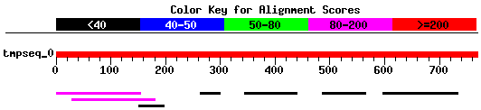
Use bioinformatics tools to search for DNA repair genes in P. falciparum
Query= Yeast DNA Repair Gene
Distribution of 7 Blast Hits on the Query Sequence
Sequences producing significant alignments: Score E
(bits) Value
Plasmodium falciparum chromosome 12,... 105 3e-23 Plasmodium falciparum chromosome 13 ... 40 0.003 Plasmodium falciparum chromosome 5 ... 35 0.099
Notes:
An example of how we could apply this information to P. falciparum is given here.
DNA repair genes from organisms such as yeast and bacteria have been cloned and characterized. The sequence information of these genes can be used to search for similar genes in the malaria parasite.
For example, the sequence of a yeast DNA repair gene can be used to search the P. falciparum genome database (for instance, using the BLAST program in NCBI). Several sequences showing homology (similarity) to the yeast gene can be identified in P. falciparum. A sequence with very high similarity can be chosen and this sequence information can then be used to clone the gene.

Slide 21
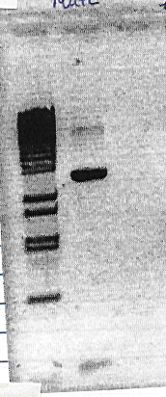
2. Clone genes from P. falciparum
PCR product
Clone gene
Notes:
Shown here is an example of a polymerase chain reaction (PCR) product of a DNA repair gene that can be generated using sequence information obtained from a BLAST search. This PCR amplification product is then cloned and used for further analyses.

Slide 22
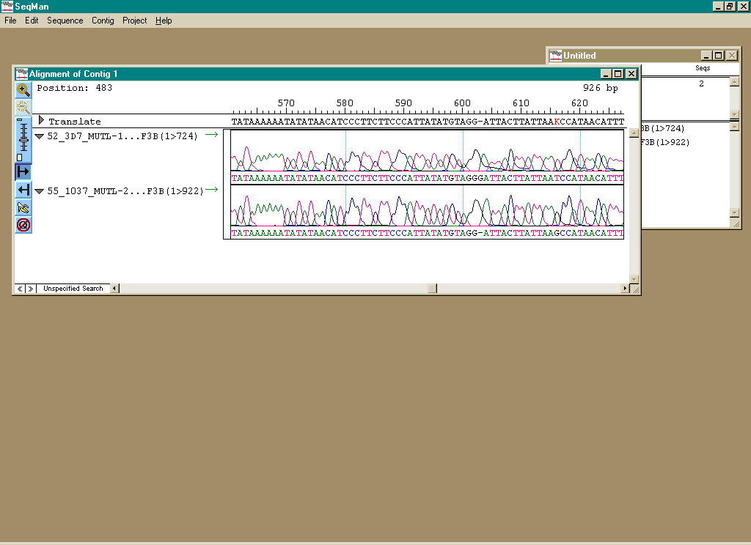
3. Search for mutations in DNA repair genes
of drug resistant parasites
Notes:
One method to determine whether a DNA repair gene is involved in drug resistance in the parasite is to analyze the sequence of the gene from malaria parasites that are sensitive or resistant to various antimalarial drugs. Shown here is an example of a sequence analysis of a DNA repair gene from two different P. falciparum strains. The arrow indicates a single nucleotide difference between the two gene sequences. Such information can then be used to see if changes in the DNA sequence such as point mutations or insertions/deletions are correlated with drug resistance in the parasite. If, for example, a mutation in a DNA repair gene is found to be correlated with drug resistance in the parasite, then this information can be used in the design of drug treatment strategies. Parasites carrying mutations in repair genes will be more likely to acquire mutations more rapidly and may be more likely to be resistant to multiple drugs. Therefore, combination malaria drug therapy could be proposed as an option for treatment.

Slide 23
Summary
Endogenous/Exogenous Factors
DNA Damage
Cell killing Repair Mutation of damage
Drug
resistance

